Slide 1
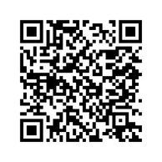

UBC Science Spotlight on Undergraduate Research
Find more Undergraduate Research:
Research Project Title (Up to three lines of text)
Insert a photo of your research here
Crop Photo to fit this frame
Summarize your project, for example: what you did, what you hope to find, and what skills you learned (up to four lines of text)
Notes:
Submission should update the following areas:
Research Project Title
Summary of Project
Photo
You do not need to modify the:
“Spotlight on Undergraduate Research” line
The Faculty of Science logo
The “Find out more here.” and QR code

Slide 2


UBC Science Spotlight on Undergraduate Research
Insert a photo of yourself
Crop Photo to fit this frame
Research Project Title (Up to two lines of text)
Your Name: (Up to one line)
Description about yourself, for example: your class standing, your specialization, where you’re from, your research interest, and anything else about you (up to six lines of text)
Find more Undergraduate Research:
Notes:
Submission should update the following areas:
Research Project Title
Summary of Project
Photo
You do not need to modify the:
“Spotlight on Undergraduate Research” line
The Faculty of Science logo
The “Find out more here.” and QR code

Slide 3
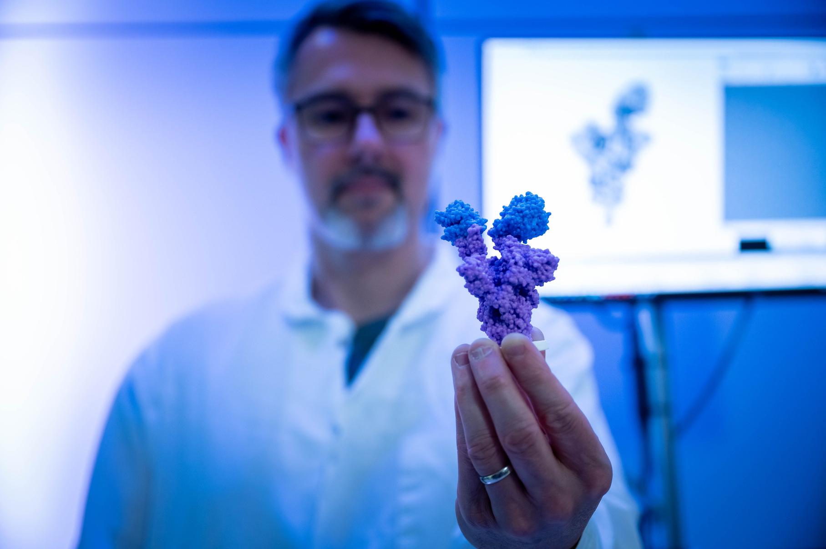
UBC Science Spotlight on Undergraduate Research
Find more Undergraduate Research:
Designing Online Profiles Using Sense of Community (SoC) Theory
Insert a photo of your research here
Crop Photo to fit this frame
Integrating SoC theory in profile designs for a haptics community platform at SPIN in hopes to facilitate knowledge sharing behaviours. I learnt more about community psychology and user experience research.
Notes:
This is an example. Feel free to delete this slide when you submit your research project.

Slide 4
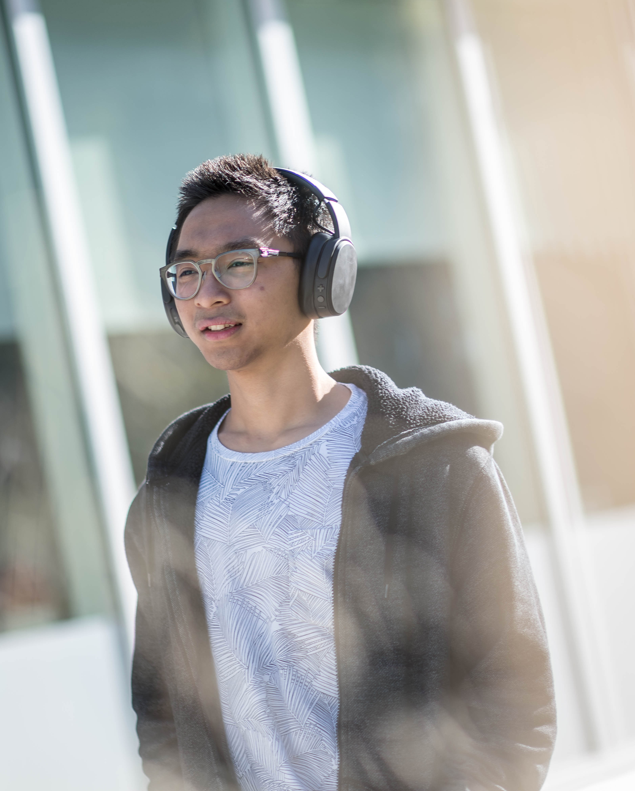
UBC Science Spotlight on Undergraduate Research
Insert a photo of yourself
Crop Photo to fit this frame
Designing Online Profiles Using Sense of Community (SoC) Theory
Bill Nye
I’m a fourth year in COGS Computational Intelligence & Design interested in learning about how people interact with design and technology.
I grew up in Singapore with an interest in animation and technology.
Find more Undergraduate Research:
Notes:
This is an example. Feel free to delete this slide when you submit your research project.

